Slide 1
Ring Component “Full Views”

Slide 2
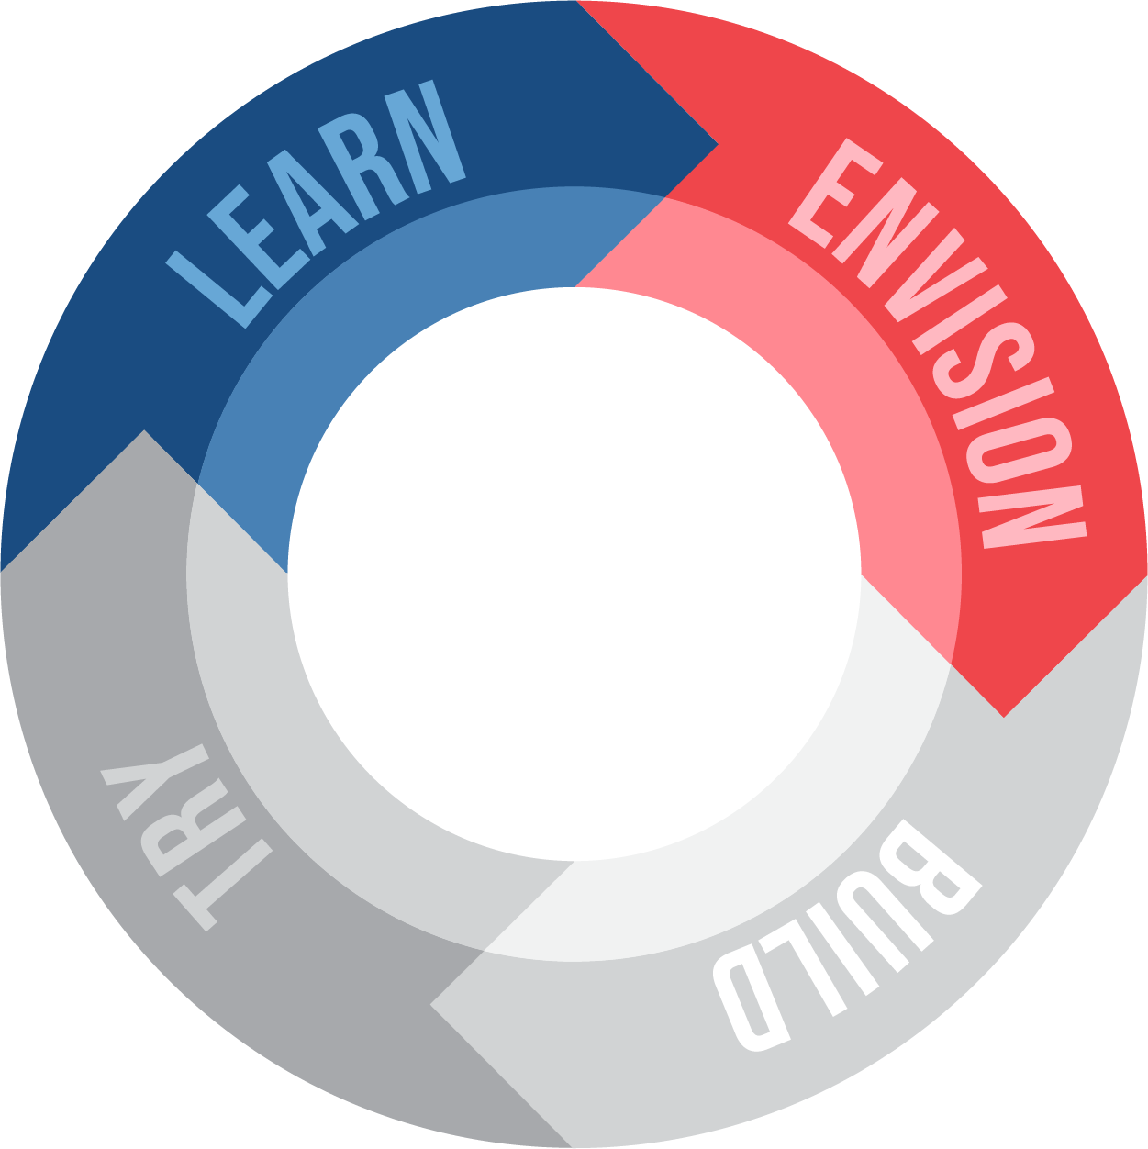
V2 Ring Components
Hover over to see what leaps it is, Priority level (H,M,L, Absent)
Data Preview Windows will ALWAYS be kept in Sync (across all components)
COMP 3
Design
Key Drivers
Conditions
►
5
2
3
►
Implementation
3
Experience
Learning & Advancement
Engagement
& Wellbeing
Standalone components should be slightly larger
5
5
2 Outcome types become the 2 scores at the bottom
Show icon for status here, hover over to see details

Slide 3
All Data Preview Windows are “scrollable”
5 rows of text, details on next slide on where to pull this information from
Shows leaps for the component, and the subcomponents
De-dupe leaps if applied in multiple places
In Standard View – show all “Key” Tools & Resources across the 7 buckets
In “Full View” show ALL Tools & Resources broken out by the 7 categories
Primary Outcomes
Teachers (names grouped by adult type)
Enrollment (who is it for.. E.g., 6th graders)
Enrollment (# Classrooms & Students)
Duration / When
Design
Conditions
(H) Leap 1
(M) Leap 2
(L) Leap 3
Will show all Student and Adult subcomponents … Adult subcomponents denoted by a “(A)”
Implementation
Subcomponent
Subcomponent
(A) Subcomponent
Supporting Resource 1
Supporting Resource 2
Key Levers
Snapshot
Leaps
Subcomponents
Tools & Resources
(H) Outcome 1
(M) Outcome 2
(L) Outcome 3
(L) Outcome 4
In Standard View – show all “Key” Practices & Approaches across the 7 buckets
Practice 1
Practice 2
Practice 3
Practice 4
List of components for which this component is a subcomponent
Shows outcomes for the component, and the subcomponents
De-dupe outcomes if applied in multiple places
Targeted Outcomes
Practices & Approaches
Embedded Locations
In “Full View” show ALL practices, broken out by the 7 categories
Only shows up if the component is embedded somewhere

Slide 4
Snapshot Data Preview Window Details
The text in bold is sample text of what you would see for each line:
This is the 1 or 2 primary outcomes that have been selected, for example:
Algebra & Critical Thinking
Primary Outcomes
Teachers (names grouped by adult type)
Enrollment (who is it for.. E.g., 6th graders)
Enrollment (# Classrooms & Students)
Duration / When
This information is pulled from the “Adults” information across the components & subcomponents, for example:
Educators (Name 1, Name 2), School Counselor (Name 1)
Snapshot
This information is pulled from the “Grade Band” choice bucket of the “Learners” Information, for example
High Schoolers … or
9th and 10th Graders
This information is pulled from the # Classroom & Students Choice Bucket in “Schedule & Use of Time” for example:
100 students across 5 classrooms
This information is pulled from the Duration & Frequency Choice Buckets in “Schedule & Use of Time” for example:
5x per week for 50 minutes

Slide 5
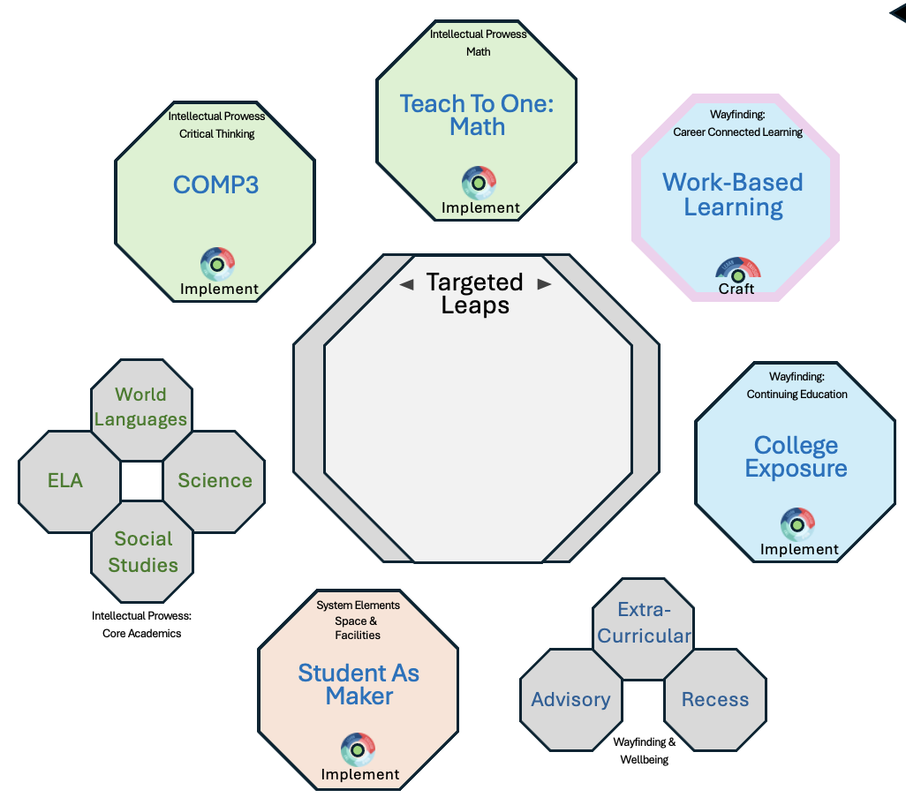

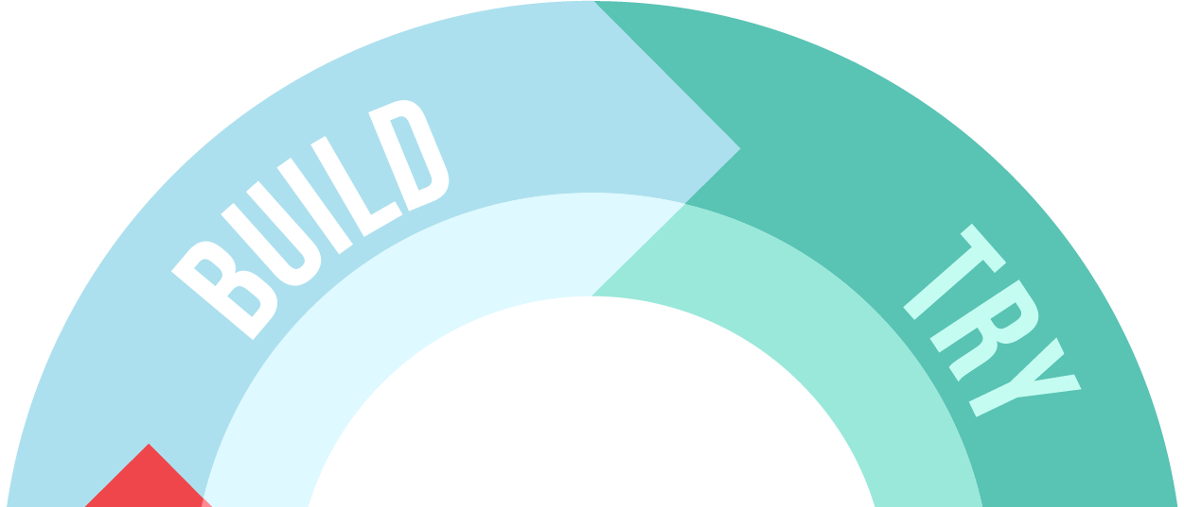
Zoomed in view will show at the top, user can navigate to other components
See a multi-data preview window version of the full view
○
• • • • •
Click to expand the data preview window
Math
Expanded Set of Outcomes Show in the Expanded View
STEM: Algebra, Calculus
Component Type Visibility Rules
Component Type = STEM or Humanities:
If it’s a course level:
Show L1: All Primary Outcomes
If it’s a Subject Level
Show L1: L2
Component Type = Crosscutting Thinking, Learning & Collaboration, Wellbeing, or Wayfinding
Show L1: Primary Outcomes (e.g., Wellbeing: Health Habits)
Note, if there are 2 primary outcomes across outcome areas, follow the same rules as above, but list both
Single click on any line item in the data preview window to open a Full View
Double click to open working space
Vision Statement
Vision statement of the component is written here, what it intends to accomplish, etc.
Snapshot
Targeted Outcomes
Leaps & DPs
Embedded Locations
Only shows if the component is embedded in another component
Algebra & Critical thinking
Educators (Name 1)
9th & 10th Graders
100 students across 10 class
5x per week for 50 mins
(H) Algebra
(M) Calculus
(M) Geometry
(L) Math Identity
(M) Customization
(L) Agency
(L) High expectation and rigorous learning
STEM Courses
Single click on title to open a full view of the Data Preview Window, Double click to open a working space
Subcomponents
Practices & Approaches
Tools & Resources
Key Levers
Subcomponent
Subcomponent
(A) Subcomponent
Key Practice 1
Key Practice 2
Key Practice 3
Key Resource 1
Key Resource 2
Key Resource 3
Design
Conditions
5
2
3
Implementation
3
Experience
Learning & Advancement
Engagement & Wellbeing
Status shows at the bottom, user can click on the this to update it to an earlier phase of the journey, and the scores will update accordingly
2
3
Craft (Month 3 of 6) ⌄

Slide 6

○
• • • • •
Math
STEM: Algebra, Calculus
Key Drivers ⌄
On hover, a collapse icon will show to bring you to the multi-data preview window view
3
5
Conditions
Design
►
2
►
Toggle to next DPW
Implementation
Click on “implementation”, to open the implementation score working space
3
Experience
Learning & Advancement
Engagement
& Wellbeing
2
-------------
3
Craft (Month 3 of 6) ⌄

Slide 7
○
• • • • •
Math
STEM: Algebra, Calculus
Vision Statement⌄
The Math Course is designed to help students—often in middle or early high school—develop a clearer understanding of the pathways, expectations, and opportunities available in higher education. The course introduces students to different types of colleges and universities, admissions requirements, and financial aid options while also giving them the chance to explore majors, careers, and campus life.
Beyond simply providing information, a college exposure course focuses on building the skills and mindsets students need to see themselves as “college-capable.” The course aims to demystify higher education, expand students’ sense of what is possible, and motivate them to take concrete steps—academically and personally—toward their postsecondary goals.
►
►
Learning & Advancement
Engagement
& Wellbeing
2
-------------
3
Craft (Month 3 of 6) ⌄

Slide 8
○
• • • • •
Math
STEM: Algebra, Calculus
Subcomponents⌄
Geometry Class
Description of Geometry Class from Subcomponent Snapshot
Calculus Class
Description of Calculus Class from Subcomponent Snapshot
Teach to One Math
Description of Teach to One Math from the Subcomponent Snapshot
►
►
Learning & Advancement
Engagement
& Wellbeing
2
-------------
3
Craft (Month 3 of 6) ⌄

Slide 9
○
• • • • •
Math
STEM: Algebra, Calculus
Targeted Outcomes⌄
Algebra (Primary, High)
Description of how Algebra applies to this component
Calculus (Medium)
Description of how Calculus applies to this component
Geometry (Medium)
Description of how Geometry applies to this component
Subcomponent
Subcomponent
Subcomponent
►
►
Subcomponent
Subcomponent
Learning & Advancement
Engagement
& Wellbeing
2
-------------
3
Craft (Month 3 of 6) ⌄

Slide 10
○
• • • • •
Math
STEM: Algebra, Calculus
Leaps⌄
Whole Child (High)
Description of how Algebra applies to this component
Customization (Medium)
Description of how Customization applies to this component
High Expectations & Rigorous Learning (Medium)
Description of how High Expectations applies to this component
Subcomponent
Subcomponent
Subcomponent
►
►
Subcomponent
Subcomponent
Learning & Advancement
Engagement
& Wellbeing
2
-------------
3
Craft (Month 3 of 6) ⌄

Slide 11
○
• • • • •
Math
STEM: Algebra, Calculus
Practices & Approaches⌄
Key Practice #1
Description of how Practice applies to this component
Key Practice #2
Description of how this practices applies to this component
Subcomponent
Subcomponent
Subcomponent
►
►
Subcomponent
Subcomponent
Subcomponent
Learning & Advancement
Engagement
& Wellbeing
2
-------------
3
Craft (Month 3 of 6) ⌄

Slide 12
○
• • • • •
Math
STEM: Algebra, Calculus
Tools & Resources ⌄
Key Tool / Resource #1
Description of how Tool/Resource applies to this component
Key Tool / Resource #2
Description of how this tool / resrouces applies to this component
Subcomponent
Subcomponent
Subcomponent
►
►
Subcomponent
Subcomponent
Subcomponent
Learning & Advancement
Engagement
& Wellbeing
2
-------------
3
Craft (Month 3 of 6) ⌄

Slide 13
○
• • • • •
Math
STEM: Algebra, Calculus
Snapshot⌄
Algebra & Critical thinking
Educators (Name 1, Name)
9th & 10th Graders
100 students across 10 class
5x per week for 50 mins
►
►
Learning & Advancement
Engagement
& Wellbeing
2
-------------
3
Craft (Month 3 of 6) ⌄

Slide 14
○
• • • • •
Math
STEM: Algebra, Calculus
Embedded Locations⌄
►
►
Learning & Advancement
Engagement
& Wellbeing
2
-------------
3
Craft (Month 3 of 6) ⌄

Slide 15
○
• • • • •
Math
STEM: Algebra, Calculus
Targeted Learners
Targeted Outcomes
Leaps & DPs
Embedded Locations
High performance-based initiation, with prior knowledge of Algebraic concepts
(H) Algebra
(H) Calculus
(M) Geometry
(L) Math Block
(M) Customization
(M) Agency
(M) High expectation and rigorous learning
STEM Courses
Subcomponents
Key Drivers
Key Elements
Student
COMP 3 Projects
Adult
Adult SEL
Design
Conditions
Tech Stations in Classroom
5
2
3
Implementation
3
Experience
Learning & Advancement
Engagement
& Wellbeing
2
-------------
3
Craft (Month 3 of 6) ⌄

Slide 16
Standard & Full View

Slide 17

Practices & Approaches Full View
Full View
/ Practices & Approaches
Practices & Approaches
Standard View
College Exposure
Practices & Approaches
Single Click opens a “Full View” or the data preview Window
►
►
Miro Link with more details
Learning & Advancement
Engagement
& Wellbeing
5
5
Miro Link with more details

Slide 18
V2 Ring Components
○
• • •
Hover over to see what leaps it is, Priority level, and if Targeted,
Dot Colors (Absent, Low, Medium, High)
○
• • • • •
COMP 3
Flags on design & Implementation score show a little flag icon
User can hover over flag to see flag details (applies to E, O, I, C, and D)
Key Drivers
2T
►
Design
Conditions
5H
►
Conditions Tailwinds and headwinds show like this
Implementation
Thriving
Experience
Learning
5
5
5
Test & Refine
Status at bottom

Slide 19

○
• • • • •
Math
STEM: Algebra, Calculus
Supporting Resources⌄
Name of SRR (Key)
Description of how SRR applies to this component
Name of SRR (Key)
Description of how SRR applies to this component
Name of SRR
Description of how SRR applies to this component
Subcomponent
Subcomponent
Subcomponent
►
►
Learning & Advancement
Engagement
& Wellbeing
2
-------------
3
Craft (Month 3 of 6) ⌄

Slide 20
Craft (Month 3 of 6) ⌄
Math
STEM: Algebra, Calculus
Key Drivers ⌄
On hover, a collapse icon will show to bring you to the multi-data preview window view
3
5
►
Design
Conditions
►
Toggle to next DPW
2
Implementation
Click on “implementation”, to open the implementation score working space
○
• • • • •
Experience
-----
Engagement & Wellbeing
Learning & Advancement
-----
2
-------------
3

Slide 21
○
• • • • •
Math
STEM: Algebra, Calculus
Leaps & DPs
Targeted Outcomes
Targeted Learners
Customization
Agency
High expectation and rigorous learning
Algebra
Calculus
Geometry
Math Block
High performance-based initiation, with prior knowledge of Algebraic concepts
Subcomponents
Key Elements
Embedded Locations
Student
COMP 3 Projects
Adult
Adult SEL
Tech Stations in Classroom
STEM Courses
Key Drivers
Design
Conditions
5
2
3
Implementation
3
Experience
Learning & Advancement
Engagement & Wellbeing
2
3
Craft (Month 3 of 6) ⌄

Slide 22
○
• • • • •
Math
STEM: Algebra, Calculus
Key Drivers ⌄
On hover, a collapse icon will show to bring you to the multi-data preview window view
2T
Design
Conditions
5H
►
►
Toggle to next DPW
Implementation
Click on “implementation”, to open the implementation score working space
Outcomes
Experience
2
--- Performance ---
3
Craft (Month 3 of 6) ⌄

Slide 23
○
• • • • •
Math
STEM: Algebra, Calculus
Description⌄
The Math Course is designed to help students—often in middle or early high school—develop a clearer understanding of the pathways, expectations, and opportunities available in higher education. The course introduces students to different types of colleges and universities, admissions requirements, and financial aid options while also giving them the chance to explore majors, careers, and campus life.
Beyond simply providing information, a college exposure course focuses on building the skills and mindsets students need to see themselves as “college-capable.” The course aims to demystify higher education, expand students’ sense of what is possible, and motivate them to take concrete steps—academically and personally—toward their postsecondary goals.
►
►
Outcomes
Experience
2
--- Performance ---
3
Craft (Month 3 of 6) ⌄

